Slide 1


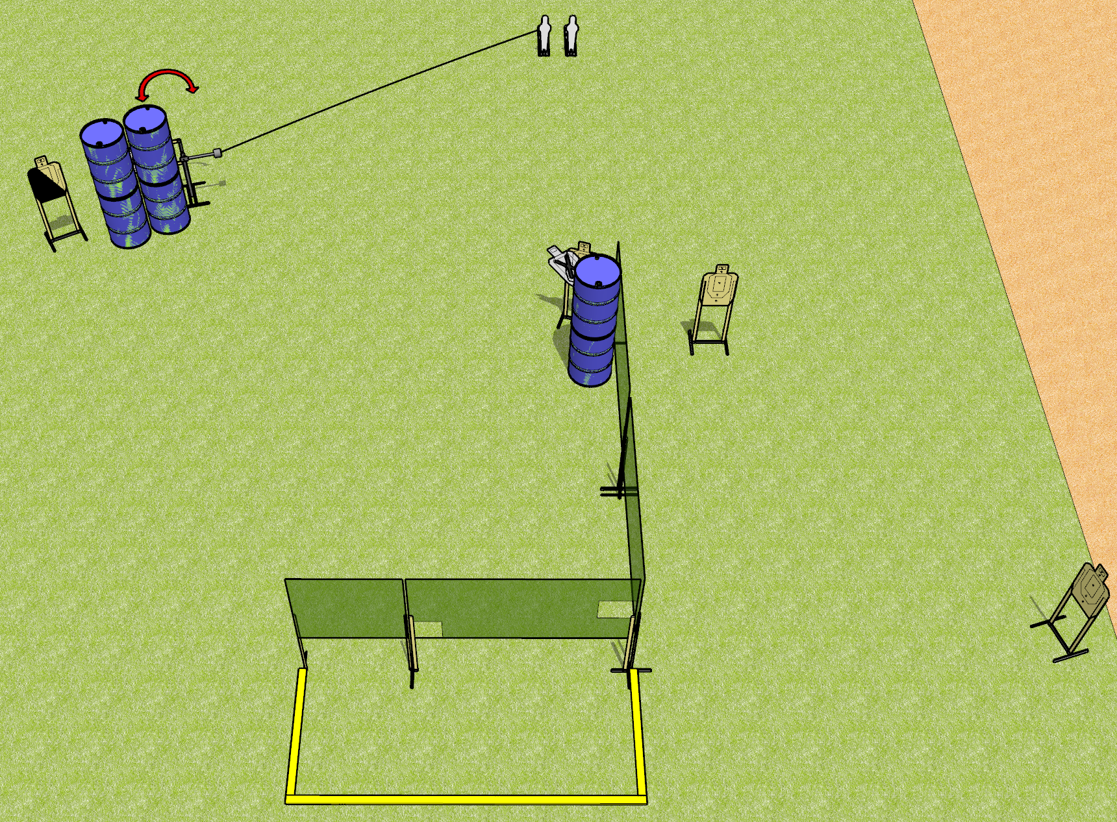
 | Dothan Gun Club – USPSA Match Three is Mean Course Designer : Drew Coleman
17 rounds 5 USPSA targets 2 USPSA mini poppers
Equipment List 5 wall feet Swinger + activator 1 diagonal HC

Slide 2
Three is Mean
Written Stage Briefing
Three is Mean is a 17 round, 85 point, Comstock medium course. There are 5 USPSA targets and 2 USPSA mini poppers. The best 3 hits on paper will score, and steel must fall to score. The start signal is audible.
The swinger is activated by the left mini popper. Please check the activator prior to walkthrough and set it the same way every time.
Handgun start position is anywhere outside the shooting area, wrists below belt. Handgun is loaded and holstered.
PCC start position is anywhere outside the shooting area. Loaded carbine is held with both hands, stock on belt, safety on.
On start signal, engage targets as they become available from within the shooting area. Perform a mandatory reload prior to the last shot fired. Failure to perform a mandatory reload prior to last shot will result in a procedural penalty.

